Slide 1
Midterm Presentation Identification of an Anonymous Reviewer of an Academic Paper
Students: Roy Hachnochi, Lior Kiassi
Supervisor: Pavel Lifshits
Semester: Spring, 2020
Date: [20/05/20]

Slide 2
Outline
Project goals and motivation.
Background.
Preparation work.
Toy problem – Workflow.
Toy problem – Results.
Future work.

Slide 3
Project Goal
Identification of an author of a text, specifically an author of a review of an academic paper.
Achieving a better understanding of how to write a review without getting de-anonymized.
Evaluate obfuscation rate of a review.

Slide 4
Motivation/Problem Statement
Commonly, as part of the process of publishing a scientific paper, the work is given to peer review.
“Double Blind” – the author and the reviewer are anonymous to each other.
Today, due to transparency reasons, several well-known journals publish the reviews.

Slide 5
NLP- Background
“Natural Language” - any language that has evolved naturally in humans through use and repetition without conscious planning or premeditation.
Can take different forms, such as speech or signing.
Distinguished from constructed and formal languages (programming languages, logic study and more).

Slide 6
NLP- Background
Natural Language Processing deals with the interaction between computers and humans using the natural language.
Mostly involves using ML and DL techniques.
Highly studied field due to relevance for Artificial Intelligence.

Slide 7
NLP- Common Problems
Speech recognition.
Machine translation.
Sentiment analysis.
Automatic summarization.
Text classification.
And many more…

Slide 8
NLP- Methods & Features
Lexical/syntactic/semantic features.
Bag-Of-Words.
Word histogram.
Language model.
N-grams.
LSTM - Long Short Term Memory.

Slide 9
Authorship Attribution - Background
An NLP task of identifying the author of a text.
Worldwide interest – wide range of applications including forensic investigation and plagiarism detection.
Various tasks:
Attribution
Profiling (age, gender and more)
Genre identification
Text clustering

Slide 10
Challenges In The Problem
No existing labeled ground truth Dataset – most reviews are anonymous.
Reviews are short texts.
Reviews are very topic related – less stylometric features.
Cross domain work.
Most academic papers are written by multiple authors.

Slide 11
Literature Survey
Online Stanford NLP course (CS224N) ⁽⁴⁾.
Summary of 2018 PAN contest - Cross-domain Authorship Attribution and Style Change Detection ⁽¹⁾.
Summary of 2019 PAN contest - Cross-Domain Authorship Attribution Task ⁽²⁾.
A thesis by Yunita Sari that elaborates about “Neural and Non-neural Approaches to Authorship Attribution” ⁽³⁾.

Slide 12
Literature Survey – Main Topics
General terms in NLP.
Useful features for Authorship Attribution.
Various solutions for Authorship Attribution – Semantic analysis, Syntactic analysis and Lexical analysis.

Slide 13
Working Environment
Python 3
Anaconda
Pycharm
Libraries: NumPy, Sklearn, Matplotlib, nltk

Slide 14
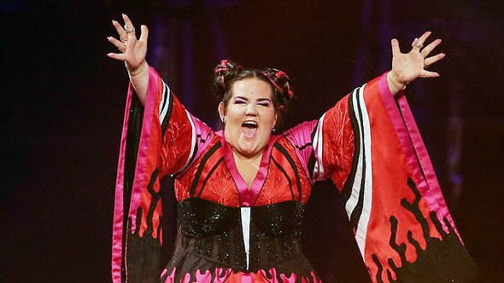
“Toy Problem”
Simple Authorship Attribution problem for first experience in the NLP field.
Small dataset: 100 texts – 10 Authors x 10 books (Guttenberg project).
Goal: create an author classifier.
I’m not your TOY!

Slide 15
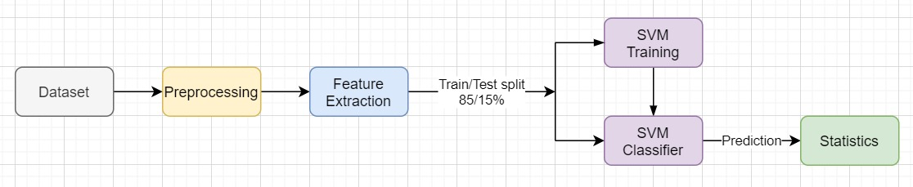
“Toy Problem”
Preprocessing:
“Cleaning” the texts
Tokenizing
Ignoring punctuation
Features⁽³⁾:
Histogram of most frequent words
Histogram of least frequent words
Average word length
Number of words

Slide 16
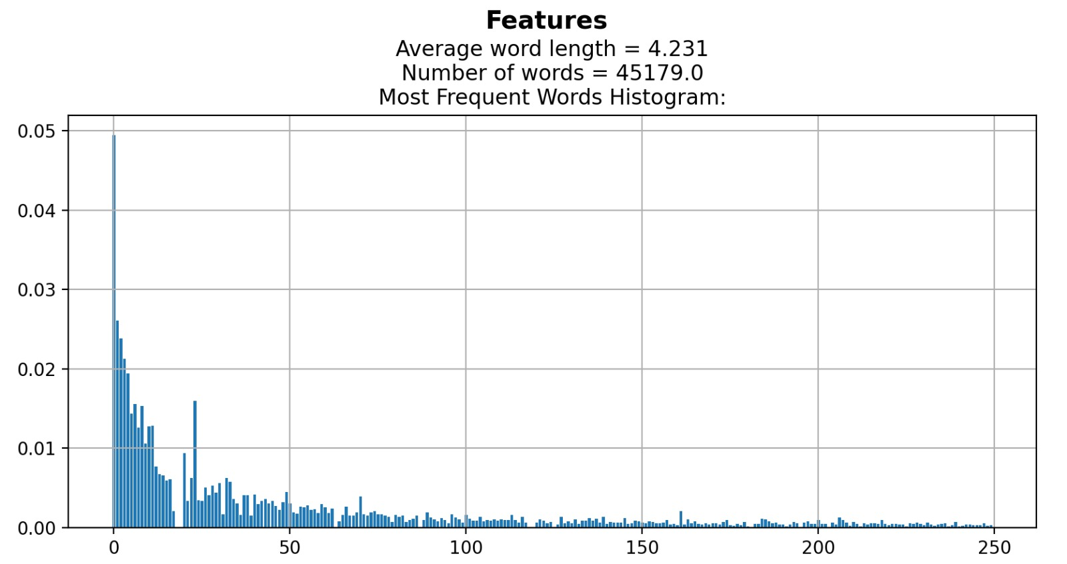
Feature Examples

Slide 17
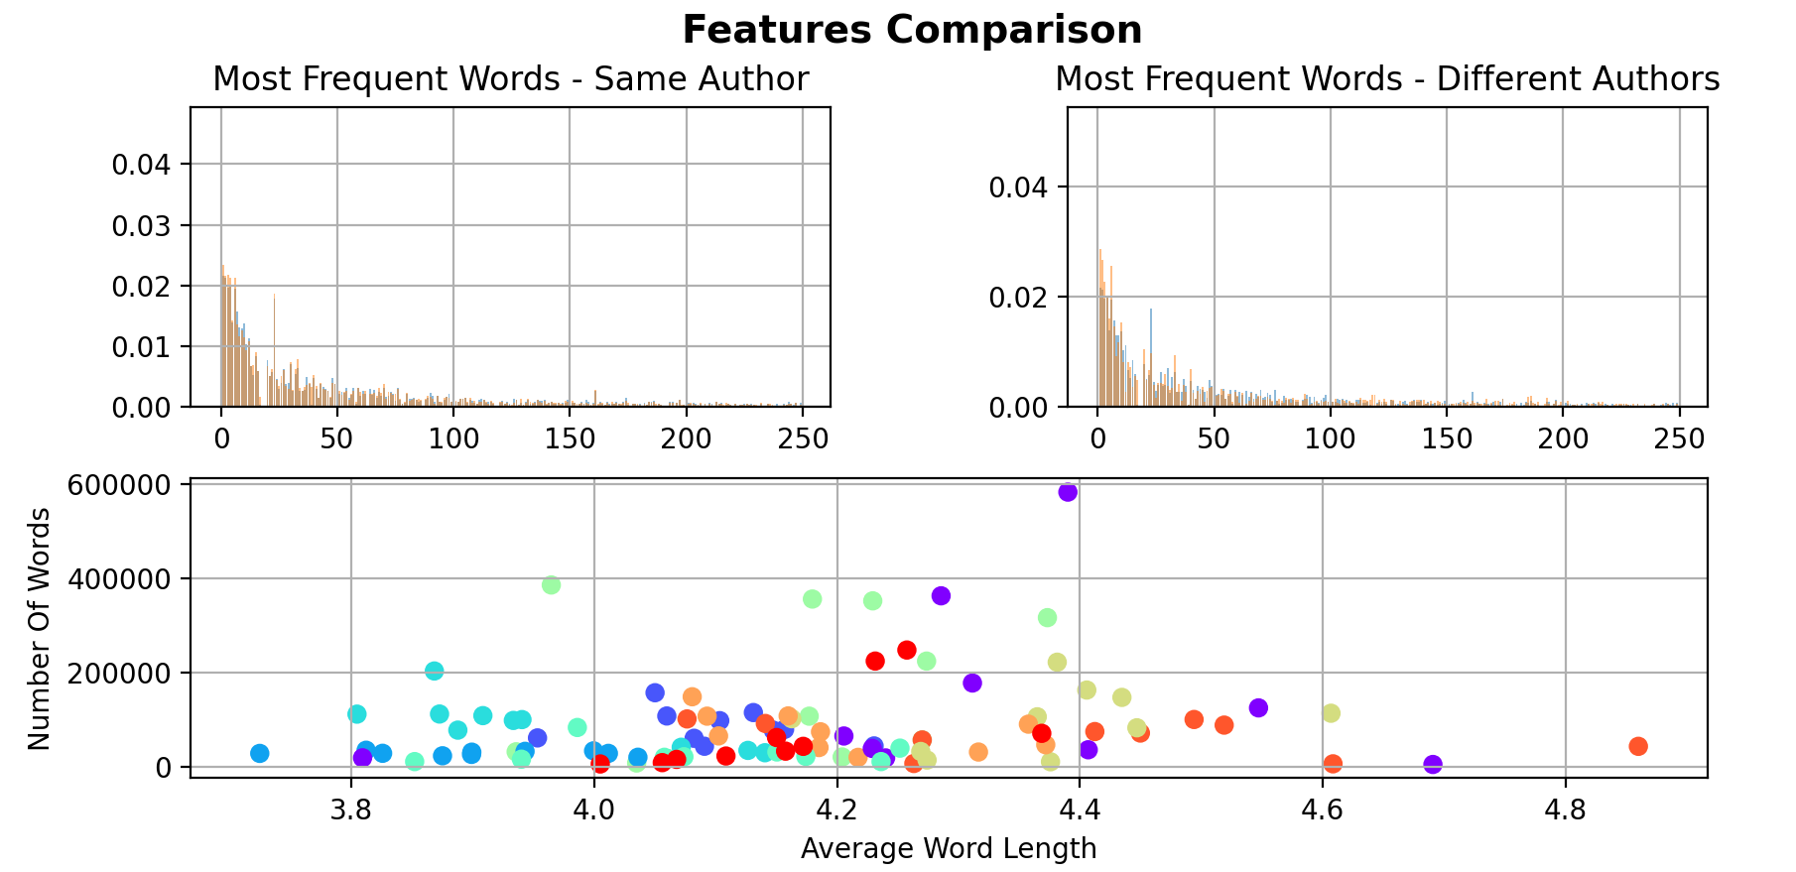

Slide 18
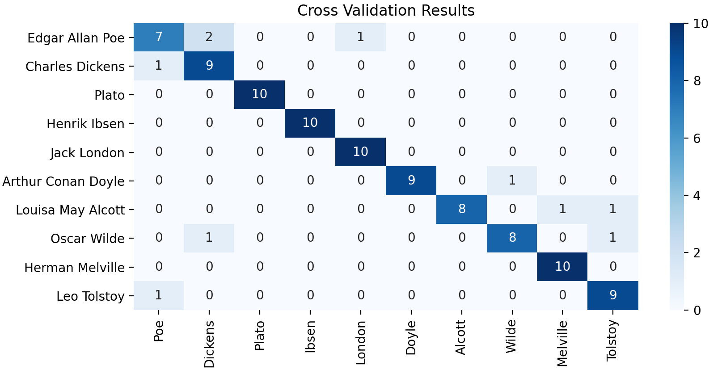
“Toy Problem” – Results
Mean Accuracy: 90%

Slide 19
Future Work
Create datasets – including preprocessing phase and finding relevant data.
Develop the model
Choose and construct the right features.
Choose a suitable classifier (DL technique?).
Build a module for analyzing results.
Test the model and analyze the results.
Project book & final presentation.

Slide 20
References
Mike Kestemont, Michael Tschuggnall, Efstathios Stamatatos, Walter Daelemans, Günther Specht, Benno Stein, and Martin Potthast. "Overview of the Author Identiﬁcation Task at PAN 2018 - Cross-domain Authorship Attribution and Style Change Detection." Avignon, France, September 10-14, 2018.
Mike Kestemont, Efstathios Stamatatos, Enrique Manjavacas, Walter Daelemans, Martin Potthast, and Benno Stein. Overview of the Cross-Domain Authorship Attribution Task at PAN 2019. Lugano, Switzerland September 09-12,2019.
Yunita Sari. "Neural and Non-neural Approaches to Authorship Attribution - A Thesis submitted to the University of Sheﬃeld for the degree of Doctor of Philosophy in the Faculty of Engineering". Department of Computer Science The University of Sheﬃeld, September 2018.
http://web.stanford.edu/class/cs224n/ - Stanford, CS224n: Natural Language Processing with Deep Learning. Instructor: Christopher Manning.
Patrick Juola. Authorship Attribution. "In Foundations and Trends in Information Retrieval", Volume 1, Issue 3, March 2008.
Moshe Koppel, Jonathan Schler, and Shlomo Argamon. "Computational Methods Authorship Attribution". Journal of the American Society for Information Science and Technology, Volume 60, Issue 1, pages 9-26, January 2009.
Efstathios Stamatatos. A Survey of Modern Authorship Attribution Methods. "Journal of the American Society for Information Science and Technology", Volume 60, Issue 3, pages 538-556, March 2009.

